Slide 1
CRYSTAL
CRYSTAL SENSATIONS
PROMOTIONAL
PRODUCT CATALOG
Premium Crystal Awards & Recognition Pieces
Limited Availability | First Come, First Served | Volume Discounts Available
www.crystalsensations.com · sales@crystalsensations.com · 1-855-946-4832

Slide 2
How To Read This Catalog
Crystal Sensations
①
SKU
②
Corporate Gift Applications & Industry Scenarios
③
Dimensions
Unique product code for ordering. Reference this SKU in all quote requests.
A practical guide to gifting occasions, industry fit, and suggested messaging, with reference to crystal shapes.
W × D × H measurements in centimeters and inches.
④
Engraving Type
⑤
Sample Artwork
⑥
Pricing Tiers
Compatible decoration methods: Subsurface Laser Engrave, Surface Etch, Color Fill, or MicroResolution UV Color Print.
Representative artwork mockup. Your logo/copy replaces sample content.
Regular · Tier 1 · Tier 2 · Tier 3. Tier pricing based on volume. Contact us for details.
⚠ LIMITED STOCK NOTICE: All promotional items are available on a first-come, first-served basis. Quantities are limited for the promotion. We are open to discussing extended supply arrangements for accounts with continuously growing order volumes. Contact us early to secure your allocation.

Slide 3
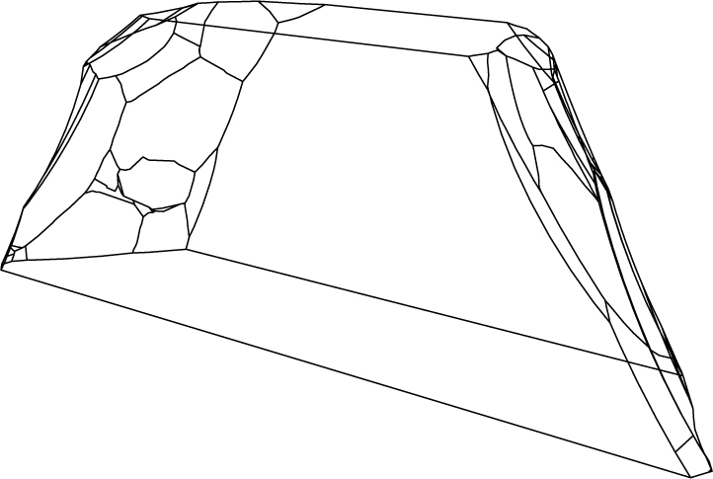
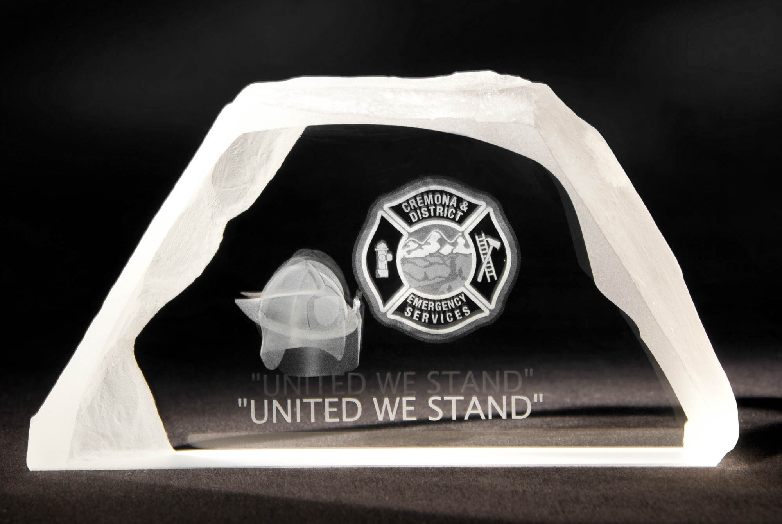
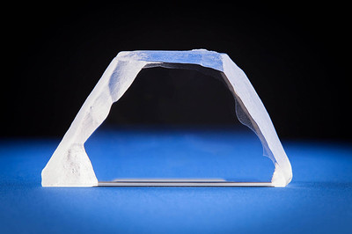
Crystal Sensations
Iceberg (5 1/8 x 2 1/2 x 1 1/2")
BEST FOR: REAL ESTATE (CONSTRUCTION), BANKING, LEADERSHIP, TECHNOLOGY
For teams who build the unsexy, essential layer everything else depends on — this is their trophy. The flat-top crystal is literally shaped like a platform. It honors the engineers and architects who built what users never see but always rely on. A meaningful, rare recognition for an often-overlooked team.
Suggested engraving “[Project name]. Built on solid ground. [Year].”
DIMENSIONS
ENGRAVING TYPES
13 W × 3.8 D X 6.5 H (cm)
LED Base: Optional
✔ Subsurface 3D Laser
✔ Surface Etching
✔ Color Fill
✔ MicroResolution UV Color Print
NET PRICING IN CAD DOLLARS
MOST POPULAR
BEST VALUE
DISTRIBUTOR REGULAR PRICING
TIER 1 (10%)
TIER 2 (12%)
TIER 3 (15%)
SKU: 13IB0K
Iceberg Crystal (5-1/8 x 1-1/2 x 2-1/2")
(1-10 units)
(11–100 units)
(100+ units)
$46.17
$41.55
$40.63
$39.24
per unit
per unit
per unit
per unit
⚠ LIMITED STOCK — FIRST COME, FIRST SERVED
Quantities are strictly limited. Open to volume discussions for accounts with continuously growing order requirements.
www.crystalsensations.com · sales@crystalsensations.com · 1-855-946-4832 · Page 3 of 6

Slide 4
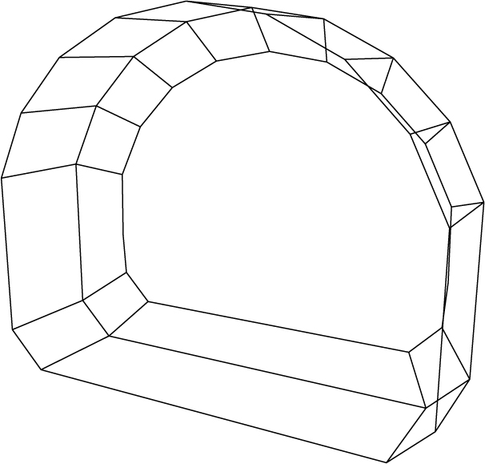
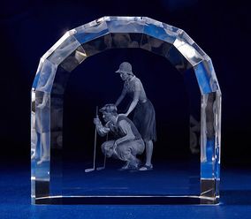
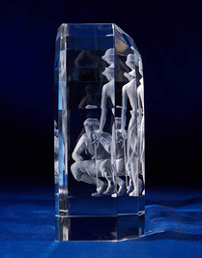
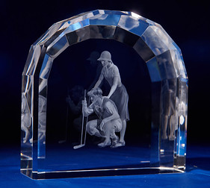
Crystal Sensations
Crystal Window Arch Award (7-1/8 x 2-3/4 x 7-1/8")
BEST FOR: EDUCATION, REAL ESTATE, COPORATE, FINANCIAL SERVICES
An arch is the universal symbol of an entrance, the threshold between before and after. When a building opens, a new branch launches, or a flagship store debuts, this award captures that exact moment. Gift it to the developer, the anchor tenant, or the project lead as a permanent marker of the day the doors opened. Suggested engraving: "[Building/Project name]. Opened [date]. Built to welcome."
DIMENSIONS
ENGRAVING TYPES
18 W × 7.2 D X 18 H (cm)
LED Base: Optional
✔ Subsurface 3D Laser
✔ Surface Etching
✔ Color Fill
✔ MicroResolution UV Color Print
NET PRICING IN CAD DOLLARS
MOST POPULAR
BEST VALUE
DISTRIBUTOR REGULAR PRICING
TIER 1 (10%)
TIER 2 (12%)
TIER 3 (15%)
SKU: 18WAB2S
Crystal Window Arch Award (7-1/8 x 2-3/4 x 7-1/8")
(1-10 units)
(11–100 units)
(100+ units)
$302.27
$272.05
$266.00
$256.93
per unit
per unit
per unit
per unit
⚠ LIMITED STOCK — FIRST COME, FIRST SERVED
Quantities are strictly limited. Open to volume discussions for accounts with continuously growing order requirements.
www.crystalsensations.com · sales@crystalsensations.com · 1-855-946-4832 · Page 3 of 6

Slide 5
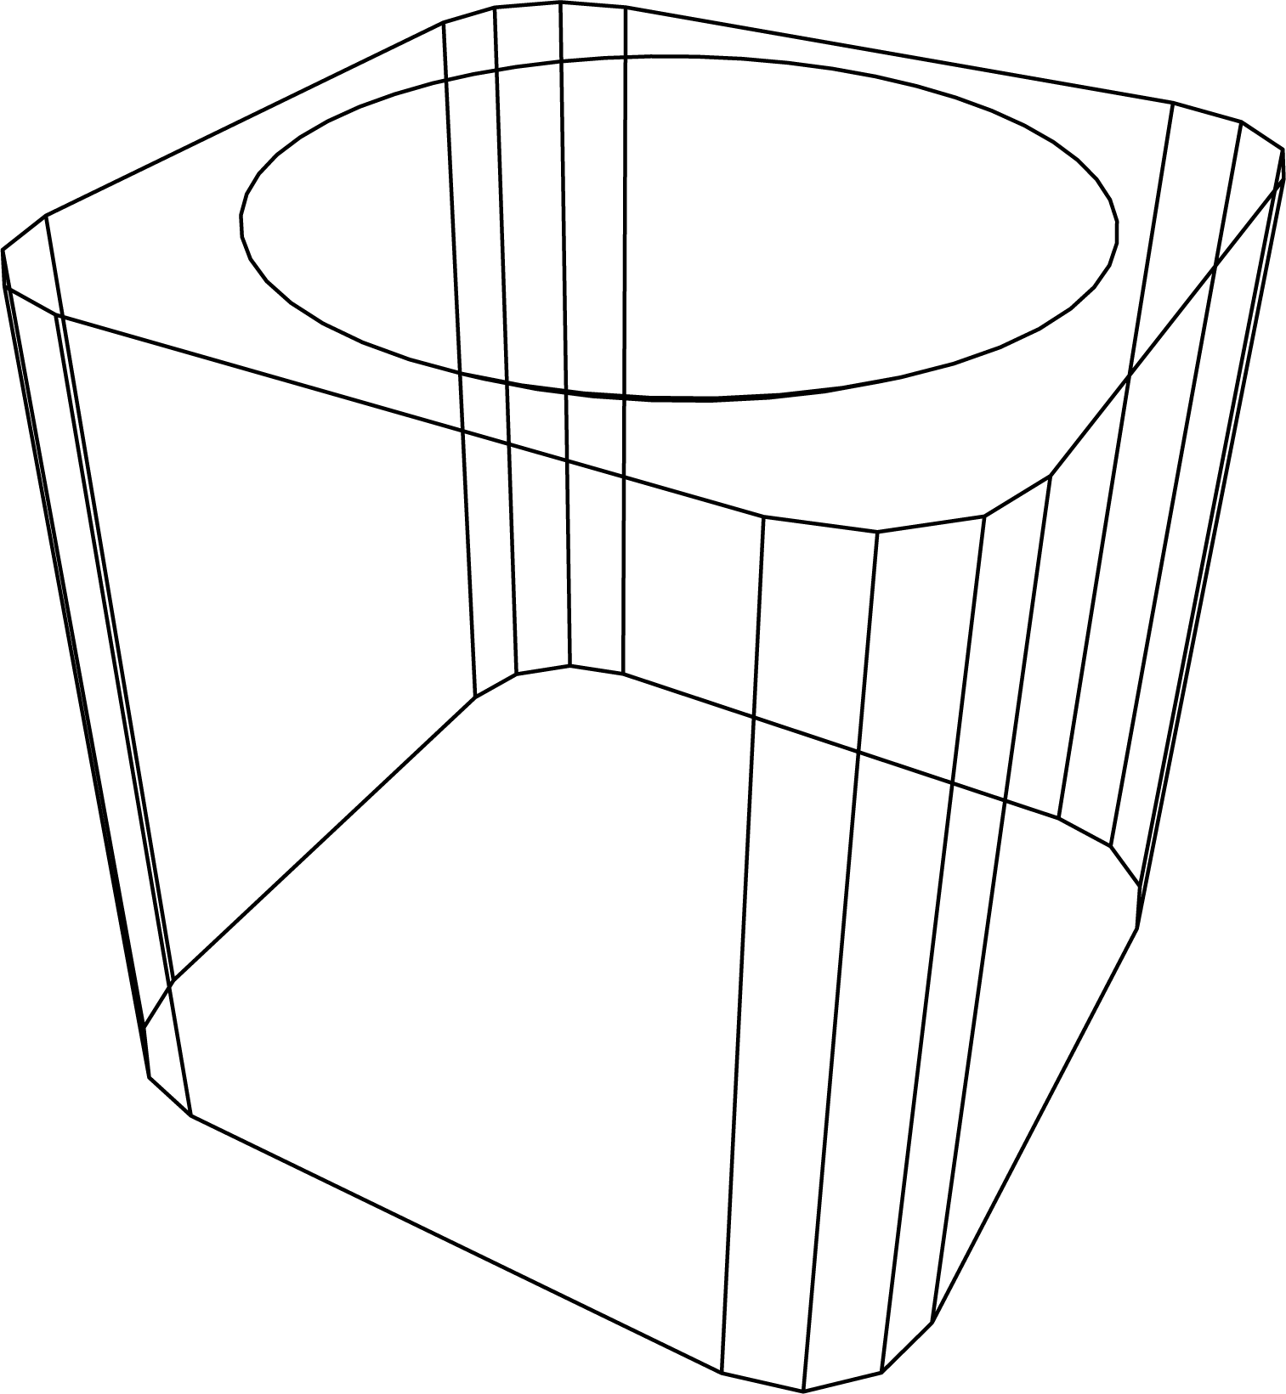
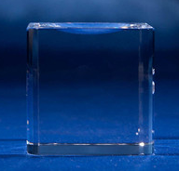
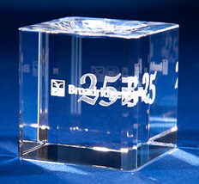
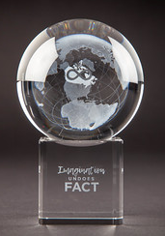
Crystal Sensations
Crystal Sphere Base (2 x 2 x 2")
BEST FOR: CONSULTING, LEGAL, EDUCATION, NON-PROFIT
The cube is the ultimate symbol of a complete, well-structured deliverable. Present this to a client at the close of a major engagement to mark the moment the work became permanent. Clear crystal communicates transparency and integrity and exactly what a trusted advisor relationship is built on.
Suggested engraving: "[Project name]. Delivered with clarity. [Firm name], [Year]."
DIMENSIONS
ENGRAVING TYPES
5 W x 5 D x 5 H (cm)
Upsell Opportunity: compatible sphere crystal, SKU 8SW (Sphere)
✔ Subsurface 3D Laser
✔ Surface Etching
✔ Color Fill
✔ MicroResolution UV Color Print
NET PRICING IN CAD DOLLARS
MOST POPULAR
BEST VALUE
DISTRIBUTOR REGULAR PRICING
TIER 1 (10%)
TIER 2 (12%)
TIER 3 (15%)
SKU: 8SBG
Crystal Sphere Base (2 x 2 x 2")
(1-10 units)
(11–100 units)
(100+ units)
$30.99
$27.89
$27.27
$26.34
per unit
per unit
per unit
per unit
⚠ LIMITED STOCK — FIRST COME, FIRST SERVED
Quantities are strictly limited. Open to volume discussions for accounts with continuously growing order requirements.
www.crystalsensations.com · sales@crystalsensations.com · 1-855-946-4832 · Page 3 of 6

Slide 6
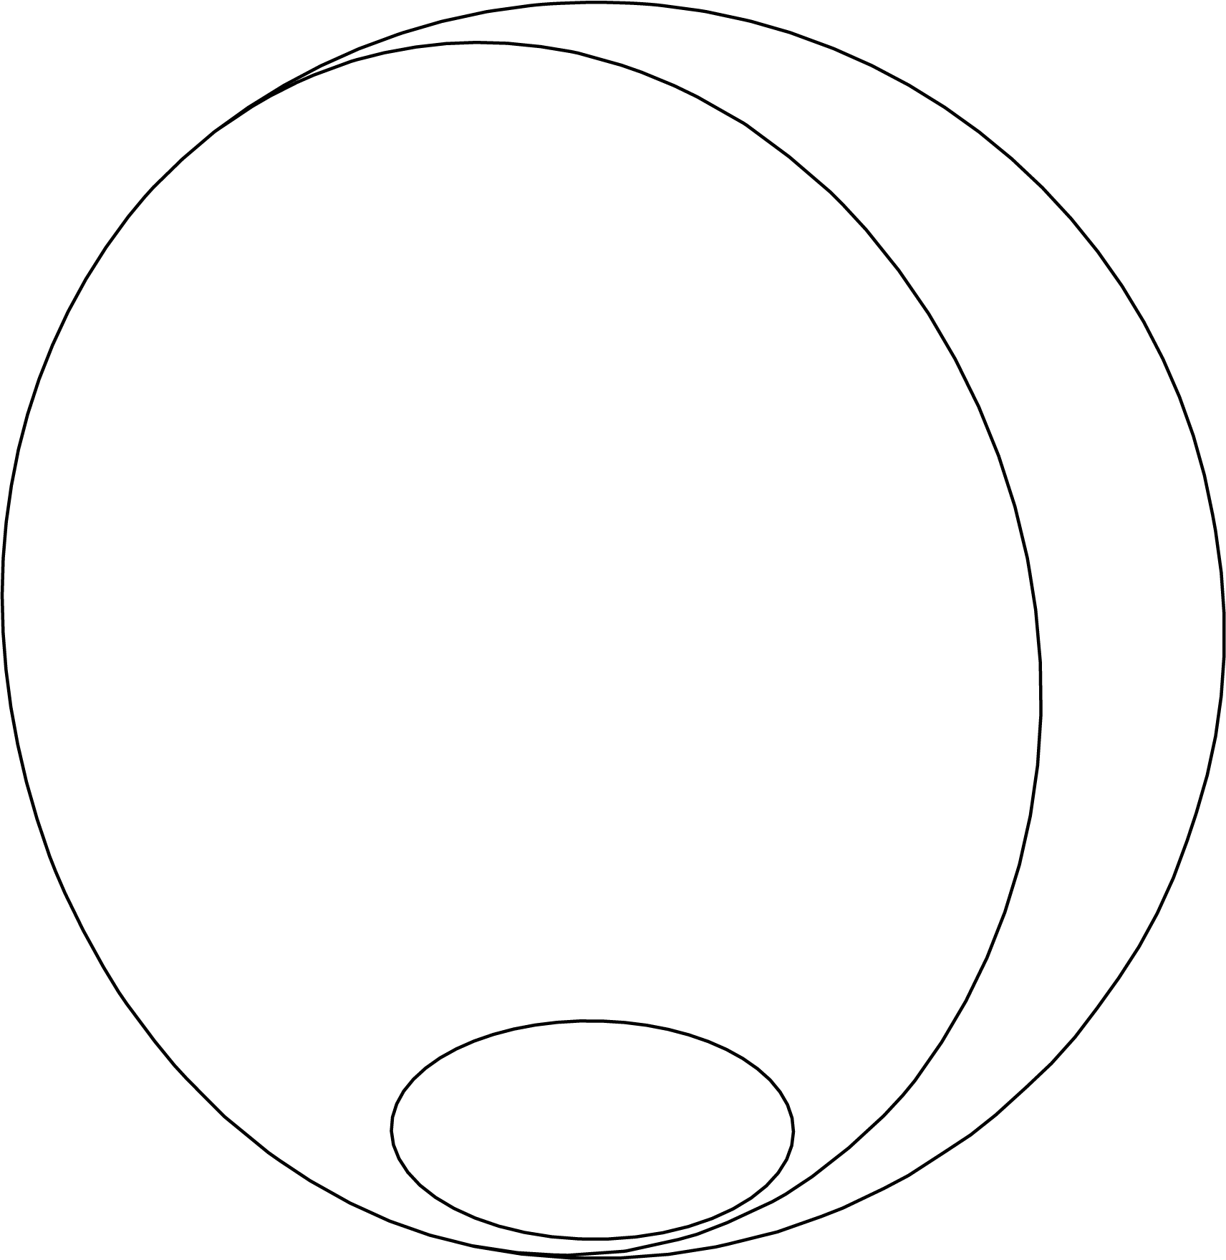
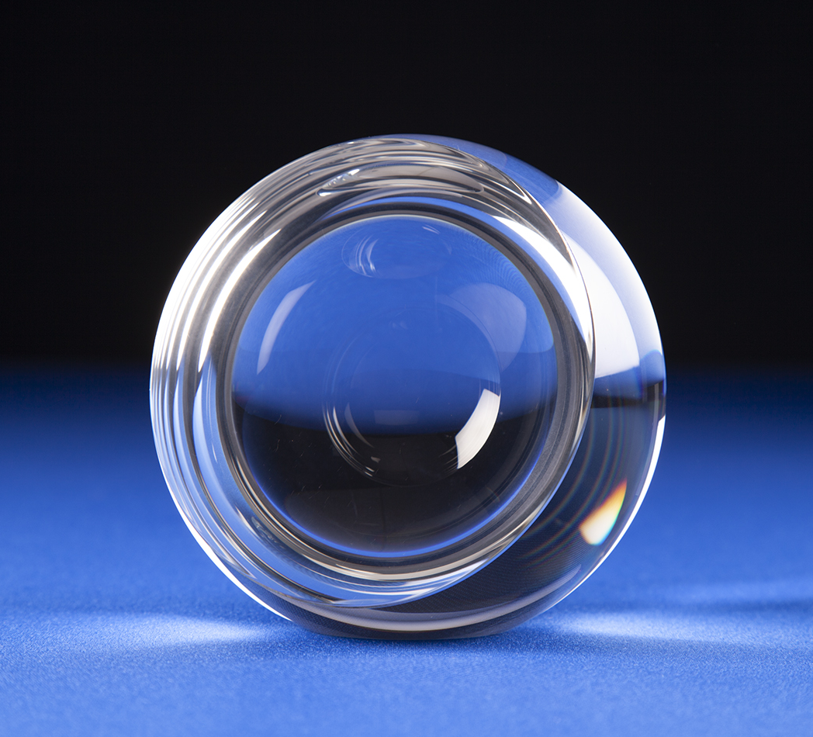
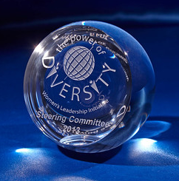
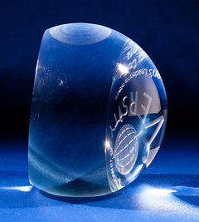
Crystal Sensations
Cut Face Sphere w/ Flat Bottom (4-3/4”)
BEST FOR: CONSULTING, MEDIA/ADVERTISING, HEALTHCARE, FINANCE
In creative industries, the highest compliment is having a singular point of view, the cut face sphere embodies exactly that. The sphere is the market, the audience, and the world; and the cut face is the unique angle only this team found. A far more meaningful trophy than a generic plaque or statuette.
Suggested engraving: "[Campaign name]. The angle no one else saw. [Agency], [Year]."
DIMENSIONS
ENGRAVING TYPES
12 Dia’ (cm)
✔ Surface Etching
✔ Color Fill
NET PRICING IN CAD DOLLARS
MOST POPULAR
BEST VALUE
DISTRIBUTOR REGULAR PRICING
TIER 1 (10%)
TIER 2 (12%)
TIER 3 (15%)
SKU: 12SFBKWIN
Cut Face Sphere w/ Flat Bottom (4-3/4“)
(1-10 units)
(11–100 units)
(100+ units)
$131.70
$118.53
$115.90
$111.95
per unit
per unit
per unit
per unit
⚠ LIMITED STOCK — FIRST COME, FIRST SERVED
Quantities are strictly limited. Open to volume discussions for accounts with continuously growing order requirements.
www.crystalsensations.com · sales@crystalsensations.com · 1-855-946-4832 · Page 3 of 6

Slide 7
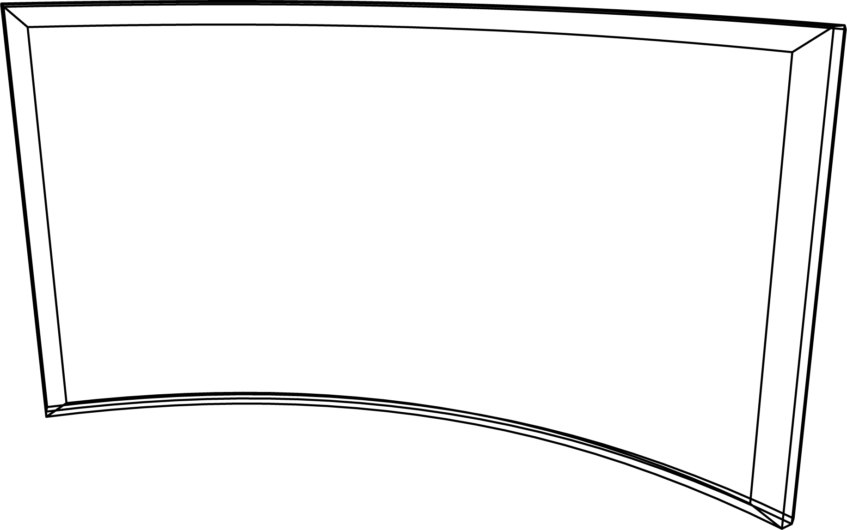
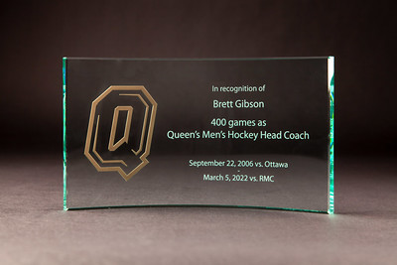
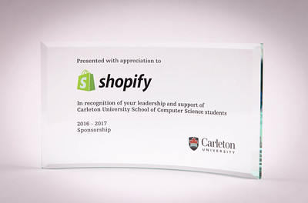
Crystal Sensations
Jade Glass Crescent (9 x 5")
BEST FOR: SPORTS, COPORATE, ACADAMIC RESEARCH, NON-PROFIT
The crescent shape tells that story without a single word. Present this to the campaign chair, the lead donor, or the board member who pushed the campaign over the line. The jade green color carries connotations of growth and prosperity that are perfectly aligned with a campaign's mission.
Suggested engraving: "[Campaign name]. The angle no one else saw. [Agency], [Year]."
DIMENSIONS
ENGRAVING TYPES
23 W x 1 D x 13 H (cm)
✔ Surface Etching
✔ Color Fill
✔ MicroResolution UV Color Print
NET PRICING IN CAD DOLLARS
MOST POPULAR
BEST VALUE
DISTRIBUTOR REGULAR PRICING
TIER 1 (10%)
TIER 2 (12%)
TIER 3 (15%)
SKU: CRES5X9X10J
Jade Glass Crescent (9 x 5")
(1-10 units)
(11–100 units)
(100+ units)
$18.30
$16.47
$16.10
$15.56
per unit
per unit
per unit
per unit
⚠ LIMITED STOCK — FIRST COME, FIRST SERVED
Quantities are strictly limited. Open to volume discussions for accounts with continuously growing order requirements.
www.crystalsensations.com · sales@crystalsensations.com · 1-855-946-4832 · Page 3 of 6

Slide 8
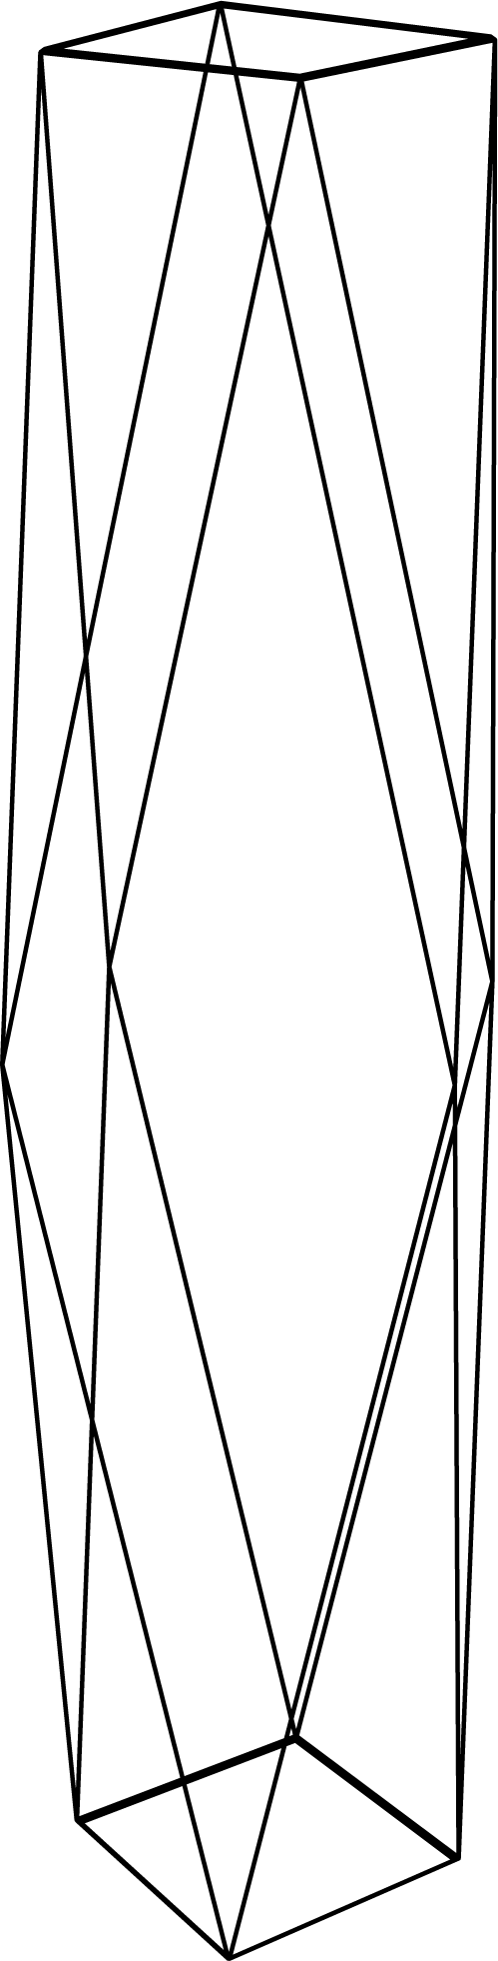
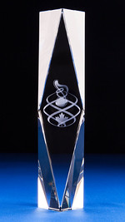
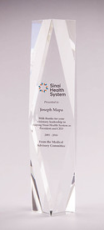
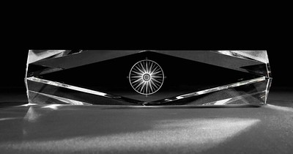
Crystal Sensations
Imperial Tower (2-3/4 x 2-3/4 x 12")
BEST FOR: CORPORATION (CXO), CONFERENCES,TECHNOLOGY
When a founder steps down or a CEO retires, the award has to match the moment. The Imperial Tower commands any room it's in: tall, faceted, and impossible to overlook. For a generation-defining tenure, this is the only piece that measures up. Suggested engraving: "[Name]. [X] years at the top. The standard others measure themselves by. [Company], [Year]."
DIMENSIONS
ENGRAVING TYPES
7 W x 7 D x 30.5 H (cm)
✔ Subsurface 3D Laser
✔ Surface Etching
✔ Color Fill
✔ MicroResolution UV Color Print
NET PRICING IN CAD DOLLARS
MOST POPULAR
BEST VALUE
DISTRIBUTOR REGULAR PRICING
TIER 1 (10%)
TIER 2 (12%)
TIER 3 (15%)
SKU: 30RBK0W
Imperial Tower (2-3/4 x 2-3/4 x 12")
(1-10 units)
(11–100 units)
(100+ units)
$88.82
$79.94
$78.17
$75.50
per unit
per unit
per unit
per unit
⚠ LIMITED STOCK — FIRST COME, FIRST SERVED
Quantities are strictly limited. Open to volume discussions for accounts with continuously growing order requirements.
www.crystalsensations.com · sales@crystalsensations.com · 1-855-946-4832 · Page 3 of 6

Slide 9
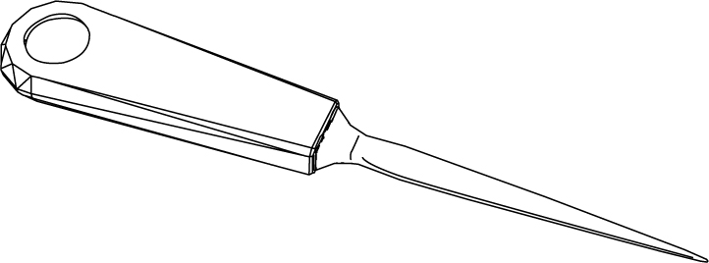
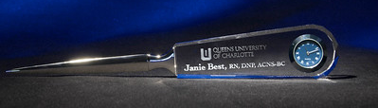
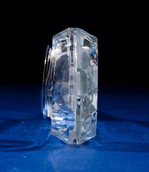
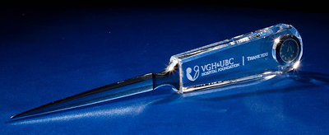
Crystal Sensations
Letter Opener w/Crystal Handle and Clock 9 5/8 x 1 3/8 x 5/8"
BEST FOR: LEGAL, FINANCE, BANKING, HR
High-net-worth clients receive wine, hampers, and branded merchandise every holiday season. A crystal letter opener sits on a desk rather than a pantry shelf. Every time they open a contract, or a personal letter, your firm's name is in their hand. That kind of daily presence is worth more than any seasonal gift. Suggested engraving: "[Client name]. Thank you for trusting us with what matters. [Firm], [Year]."
DIMENSIONS
ENGRAVING TYPES
24.5 W x 1.5 D x 3.5 H (cm)
✔ Subsurface 3D Laser
✔ Surface Etching
✔ Color Fill
✔ MicroResolution UV Color Print
NET PRICING IN CAD DOLLARS
MOST POPULAR
BEST VALUE
DISTRIBUTOR REGULAR PRICING
TIER 1 (10%)
TIER 2 (12%)
TIER 3 (15%)
SKU: LOC25W
Letter Opener w/Crystal Handle and Clock 9 5/8 x 1 3/8 x 5/8"
(1-10 units)
(11–100 units)
(100+ units)
$34.51
$31.06
$30.37
$29.33
per unit
per unit
per unit
per unit
⚠ LIMITED STOCK — FIRST COME, FIRST SERVED
Quantities are strictly limited. Open to volume discussions for accounts with continuously growing order requirements.
www.crystalsensations.com · sales@crystalsensations.com · 1-855-946-4832 · Page 3 of 6

Slide 10
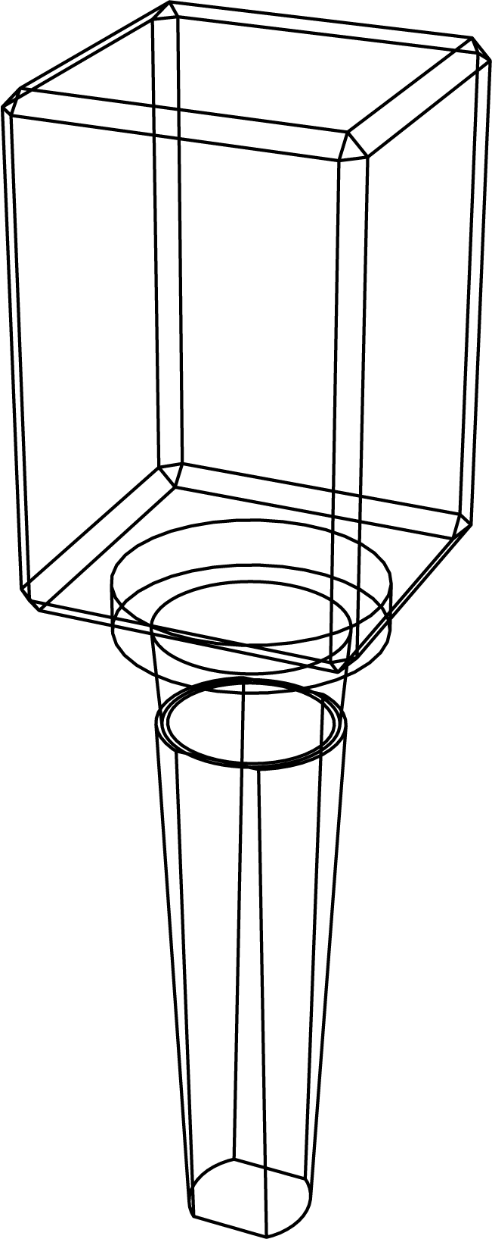
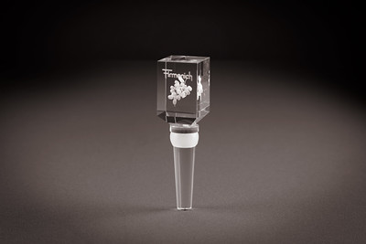
Crystal Sensations
Crystal Tapered Rectangle Wine Bottle Stopper with Glass Stem 1 1/8 x 1 1/8 x 1 7/8
BEST FOR: HOSPITALITY, CORPORATE, FINANCE, PERSONAL MILESTONES / WEDDING
A crystal wine stopper engraved with a vineyard, label, or landmark is something a sommelier or restaurateur displays proudly, not stuffs in a drawer. On-brand, on-industry, and genuinely worth keeping.
Suggested engraving: "[Winery/Restaurant name]. Est. [Year]. Every bottle tells a story."
DIMENSIONS
ENGRAVING TYPES
2.8 W x 2.8 D x 4.7 H (cm)
✔ Subsurface 3D Laser
✔ Surface Etching
✔ Color Fill
✔ MicroResolution UV Color Print
NET PRICING IN CAD DOLLARS
MOST POPULAR
BEST VALUE
DISTRIBUTOR REGULAR PRICING
TIER 1 (10%)
TIER 2 (12%)
TIER 3 (15%)
SKU: WB3MRWGS
Crystal Tapered Rectangle Wine Bottle Stopper with Glass Stem 1-1/8 x 1-1/8 x 1-7/8
(1-10 units)
(11–100 units)
(100+ units)
$19.49
$17.54
$17.15
$16.57
per unit
per unit
per unit
per unit
⚠ LIMITED STOCK — FIRST COME, FIRST SERVED
Quantities are strictly limited. Open to volume discussions for accounts with continuously growing order requirements.
www.crystalsensations.com · sales@crystalsensations.com · 1-855-946-4832 · Page 3 of 6

Slide 11
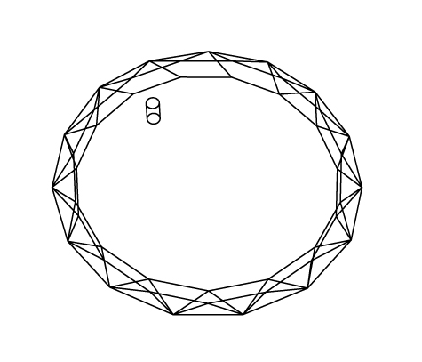
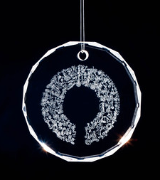
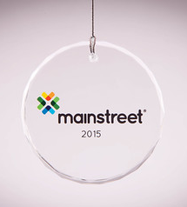
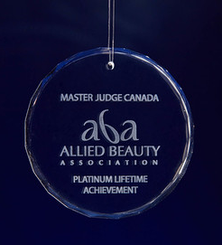
Crystal Sensations
Circle Crystal Suncatcher Ornament 2 1/2 x 1/4"
BEST FOR: COPORATE, NON-PROFIT, EDUCATION, PERSONAL MILESTONES / WEDDING
For a memorial service or tribute event, this is a keepsake attendees will hang in a window and think of every time the sun hits it. Gentle, meaningful, and deeply appropriate for a moment that calls for something lasting but not heavy.
Suggested engraving: "[Name]. [Date]. Still casting light."
DIMENSIONS
ENGRAVING TYPES
6.5 Dia’ x 0.5 D (cm)
✔ Surface Etching
✔ Color Fill
✔ MicroResolution UV Color Print
NET PRICING IN CAD DOLLARS
MOST POPULAR
BEST VALUE
DISTRIBUTOR REGULAR PRICING
TIER 1 (10%)
TIER 2 (12%)
TIER 3 (15%)
SKU: SOCB0W
Circle Crystal Suncatcher Ornament 2-1/2 x 1/4"
(1-10 units)
(11–100 units)
(100+ units)
$15.01
$13.51
$13.21
$12.76
per unit
per unit
per unit
per unit
⚠ LIMITED STOCK — FIRST COME, FIRST SERVED
Quantities are strictly limited. Open to volume discussions for accounts with continuously growing order requirements.
www.crystalsensations.com · sales@crystalsensations.com · 1-855-946-4832 · Page 3 of 6

Slide 12
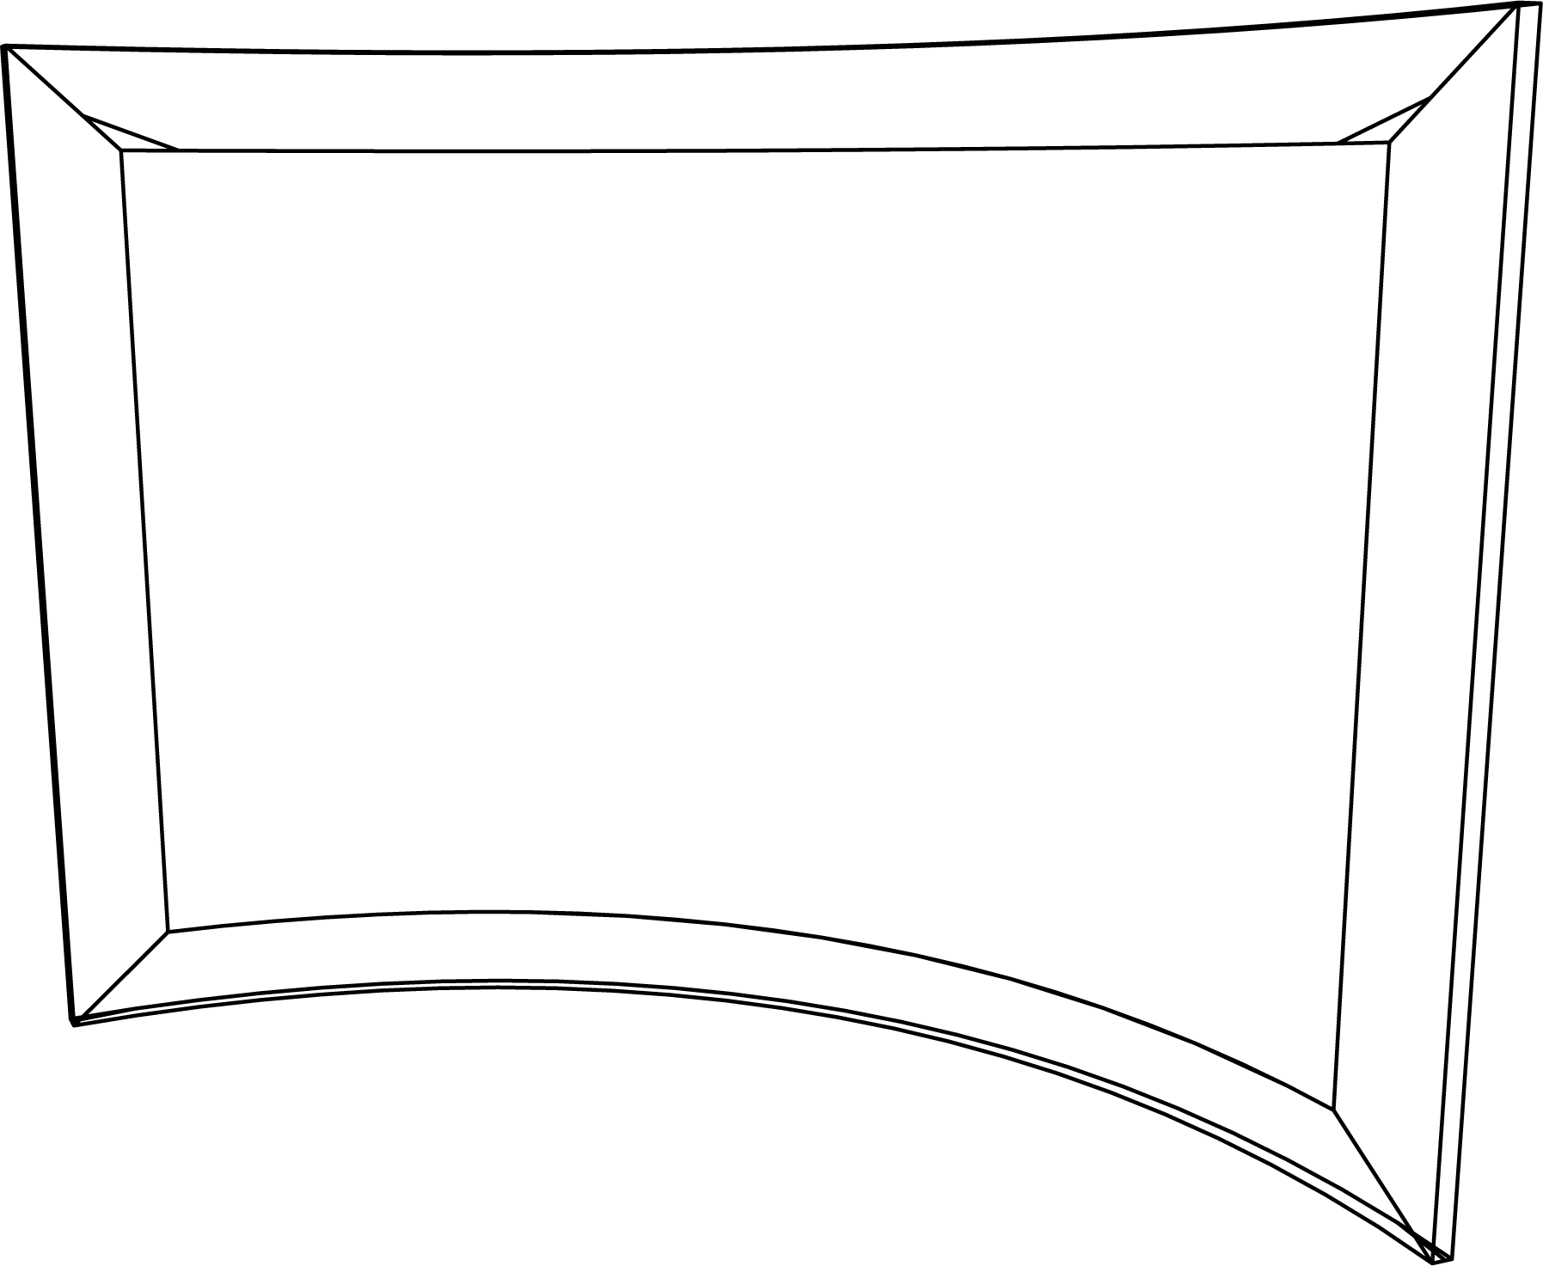
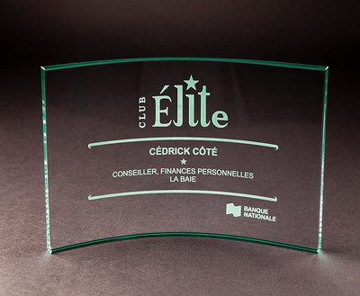
Crystal Sensations
Jade Glass Crescent (4 x 6")
BEST FOR: FINANCE, HEALTHCARE, RETAIL, MEMBER ORGANIZATIONS
Healthcare recognition demands something that feels clinical in its precision and warm in its intent. The jade crescent delivers both. Compact enough to fit on a crowded physician's desk, distinctive enough to stand out among the standard framed certificates lining the wall. Suggested engraving: "[Name]. [Specialty/Title]. Excellence in patient care. [Organization], [Year]”
DIMENSIONS
ENGRAVING TYPES
15 W x 0.5 D x 10 H (cm)
✔ Surface Etching
✔ Color Fill
✔ MicroResolution UV Color Print
NET PRICING IN CAD DOLLARS
MOST POPULAR
BEST VALUE
DISTRIBUTOR REGULAR PRICING
TIER 1 (10%)
TIER 2 (12%)
TIER 3 (15%)
SKU: CRES4X6X5J
Jade Glass Crescent (4 x 6")
(1-10 units)
(11–100 units)
(100+ units)
$12.96
$11.66
$11.40
$11.02
per unit
per unit
per unit
per unit
⚠ LIMITED STOCK — FIRST COME, FIRST SERVED
Quantities are strictly limited. Open to volume discussions for accounts with continuously growing order requirements.
www.crystalsensations.com · sales@crystalsensations.com · 1-855-946-4832 · Page 3 of 6

Slide 13
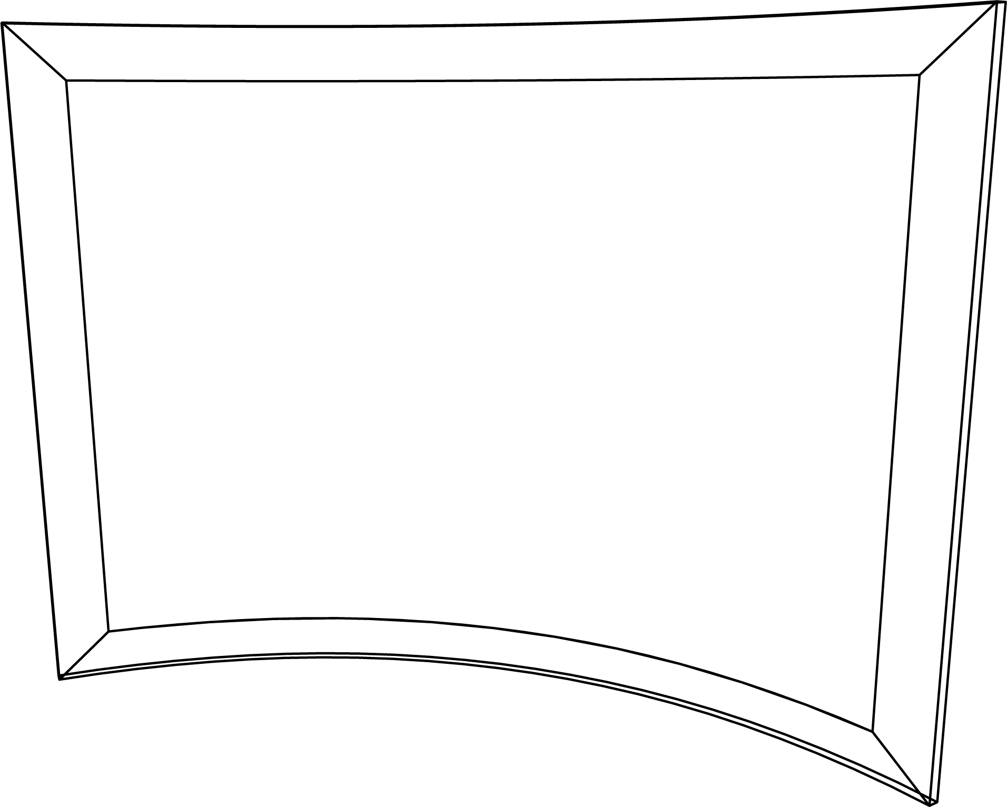
Crystal Sensations
Jade Glass Crescent (5 x 7")
BEST FOR: FINANCE, HEALTHCARE, RETAIL, MEMBER ORGANIZATIONS
The sample says it all "Club Élite" engraved on jade glass is exactly the right tone for a top-tier advisor program. The jade green edge signals premium without being loud. It sits on a financial advisor's desk and quietly tells every client who walks in: this person is recognized as among the best. Suggested engraving: "[Club name]. [Name]. [Title]. [Year]."
DIMENSIONS
ENGRAVING TYPES
18 W x 0.5 D x 13 H (cm)
✔ Surface Etching
✔ Color Fill
✔ MicroResolution UV Color Print
NET PRICING IN CAD DOLLARS
MOST POPULAR
BEST VALUE
DISTRIBUTOR REGULAR PRICING
TIER 1 (10%)
TIER 2 (12%)
TIER 3 (15%)
SKU: CRES5X7X5J
Jade Glass Crescent (5 x 7")
(1-10 units)
(11–100 units)
(100+ units)
$15.90
$14.31
$13.99
$13.52
per unit
per unit
per unit
per unit
⚠ LIMITED STOCK — FIRST COME, FIRST SERVED
Quantities are strictly limited. Open to volume discussions for accounts with continuously growing order requirements.
www.crystalsensations.com · sales@crystalsensations.com · 1-855-946-4832 · Page 3 of 6

Slide 14
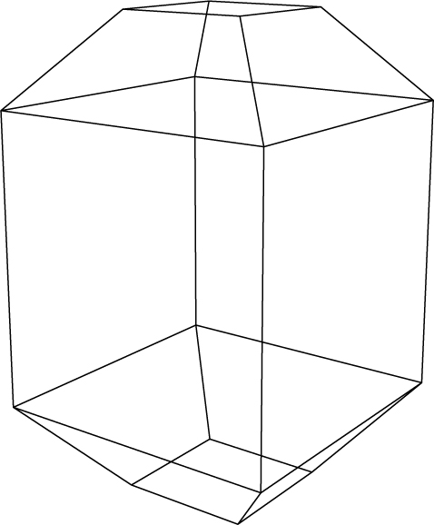
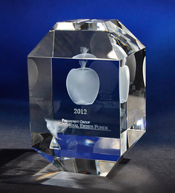
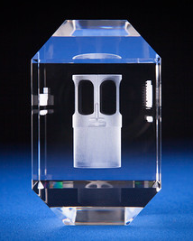
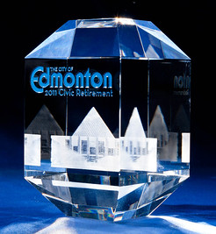
Crystal Sensations
Crystal Faberge Award (2 3/4 x 2 3/4 x 4 1/2")
BEST FOR: REAL ESTATE, FINANCE, INSURANCE, EXECUTIVES, HR
The Crystal Faberge Award recognizes top producers with a piece they'll proudly display. Laser-engraved with your agent's name, presentation-ready in a velvet gift box, it becomes a completely personal tribute to individual achievement. Suggested engraving: “[Company Name] Top Producer Award / In recognition of exceptional performance and commitment to excellence [Client’s Name] [Year]”
DIMENSIONS
ENGRAVING TYPES
7 W x 7 D x 11.5 H (cm)
✔ Subsurface 3D Laser
✔ Surface Etching
✔ Color Fill
✔ MicroResolution UV Color Print
NET PRICING IN CAD DOLLARS
MOST POPULAR
BEST VALUE
DISTRIBUTOR REGULAR PRICING
TIER 1 (10%)
TIER 2 (12%)
TIER 3 (15%)
SKU: 70FMB0W
Crystal Faberge Award (2-3/4 x 2-3/4 x 4-1/2")
(1-10 units)
(11–100 units)
(100+ units)
$49.00
$44.10
$43.12
$41.65
per unit
per unit
per unit
per unit
⚠ LIMITED STOCK — FIRST COME, FIRST SERVED
Quantities are strictly limited. Open to volume discussions for accounts with continuously growing order requirements.
www.crystalsensations.com · sales@crystalsensations.com · 1-855-946-4832 · Page 3 of 6

Slide 15
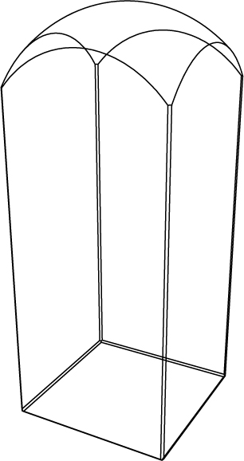
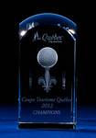
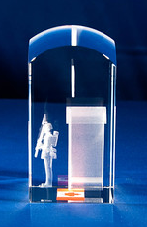
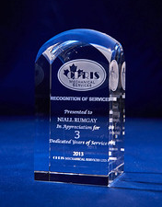
Crystal Sensations
Crystal Dome Tower Award (2 x 2 x 4")
BEST FOR: REAL ESTATE, ARCHITECTURE, FINANCE, TECHNOLOGY, HOSPITALITY
A modern piece that is tall, with an architectural silhouette and a softly curved dome top, reflecting upward momentum and enduring success, making it an ideal choice for honoring top performers, milestone achievements, and leadership excellence. Suggested Engraving: Excellence Award Presented to [Client’s Name] In recognition of outstanding performance [Company Name] | [Year]
DIMENSIONS
ENGRAVING TYPES
5 W x 5 D x 10 H (cm)
✔ Subsurface 3D Laser
✔ Surface Etching
✔ Color Fill
✔ MicroResolution UV Color Print
NET PRICING IN CAD DOLLARS
MOST POPULAR
BEST VALUE
DISTRIBUTOR REGULAR PRICING
TIER 1 (10%)
TIER 2 (12%)
TIER 3 (15%)
SKU: 10DSB0W
Crystal Dome Tower Award (2 x 2 x 4")
(1-10 units)
(11–100 units)
(100+ units)
$26.40
$23.76
$23.23
$22.44
per unit
per unit
per unit
per unit
⚠ LIMITED STOCK — FIRST COME, FIRST SERVED
Quantities are strictly limited. Open to volume discussions for accounts with continuously growing order requirements.
www.crystalsensations.com · sales@crystalsensations.com · 1-855-946-4832 · Page 3 of 6

Slide 16
READY TO ORDER?
Contact our team today — quantities are limited and allocations fill fast.
PHONE
EMAIL
Online Platform
ADDRESS
1-855-946-4832
sales@crystalsensations.com
www.crystalsensations.com
ASI #47787
SAGE #66376 (US)
SAGE #68900 (CA)
950 Denison St, Unit 19
Markham, ON
Canada, L3R 3K5
⚠ IMPORTANT: All promotional items are available on a strictly limited, first-come-first-served basis. We welcome ongoing supply discussions for clients with growing and consistent order volumes.
Amazing. Redefined.™

